Slide 1



Music Machine Learning
VI – Latent models and EM algorithm
Master ATIAM - Informatique
Philippe Esling (esling@ircam.fr)
Maître de conférences – UPMC
Equipe représentations musicales (IRCAM, Paris)

Slide 2


Supervised learning
We have dealt with supervised problems
Classification, regression
Implies that we have labels
Based on labeled data, find class of unlabeled
Multiple approaches to do so
In probabilistic terms we can express this
We have data and labels
Supervised learning tries to model
As we define a parametric model
Optimization might be seen as solving for
Graphical model

Slide 3
Unsupervised learning
Now imagine we only have
No labels are available
Structure exists in any data
As humans we see it easily
How to learn from this
Here we can clearly see four clusters
This is a form of unsupervised structure
Introducing unsupervised clustering
Could we model the distribution ?
Three major issues :
How to choose the form of the distribution ?
How to optimize it directly ?
There seems to be missing information

Slide 4

Unsupervised learning
We need to add information to our problem, but only have
Here our structure is clearly defined by the cluster identity
Introducing the need for latent variables
Allows to clearly define the hidden information
We structure the problem with factors that generated the data
Latent (unsupervised)
Supervised

Slide 5
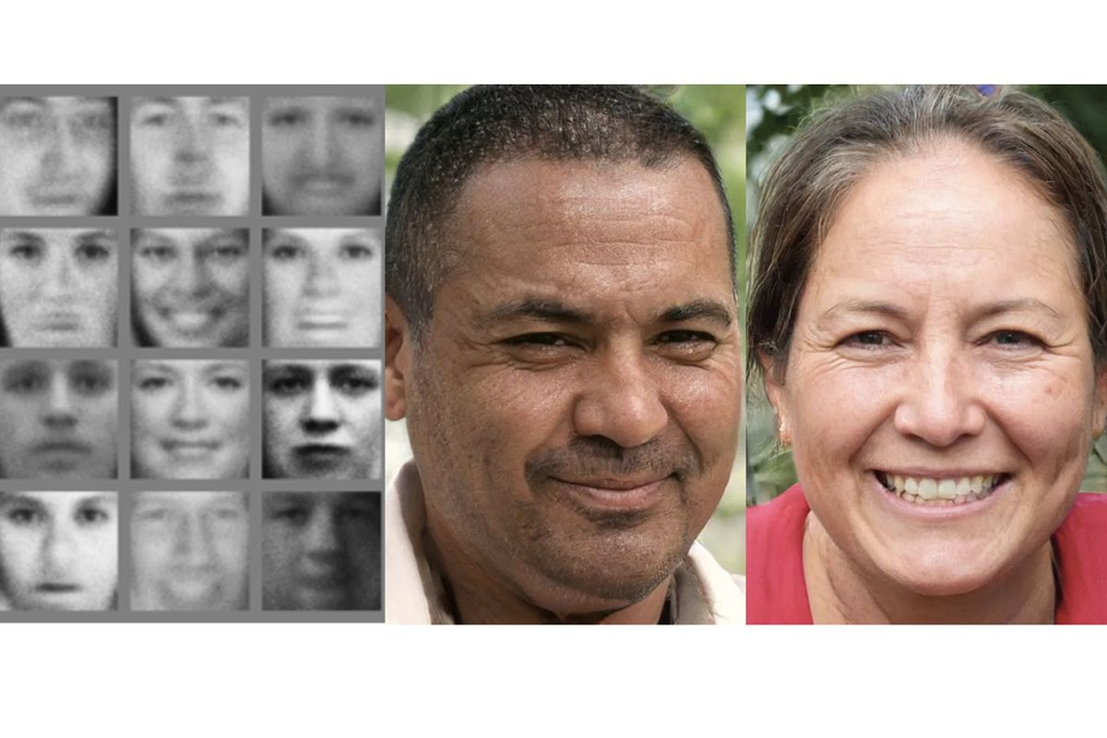

Probabilistic generative models
Later we might be interested in the generative problem
Remember this problem is very arduous
So we introduce latent variables
Happy, female
Neutral, male
You can understand latent variables as
Hidden variables that might have led to generate the data
Hidden variation factors in the data structure
Variables that simplify our optimization task

Slide 6
Defining clustering
Here we address clustering tasks
Attach label to each observation or data points in a set
You can say this is “unsupervised classification”
You want to assign same label to data points that are “close”
Clustering algorithms rely on a distance metric between data points
Data (input)
Unsupervised Learning
‘Interesting structure’ (output)
Objective function ?
Should contain essential traits and discard unessential details
We will first address this in a non-probabilistic and naive way
How can we perform clustering on a given set of points ?

Slide 7
Clustering intuition
What defines a good clustering ?
Evaluate the within-clusters distance (centroid-based)
C₁
C₂
If we knew the memberships of points
We could infer centroids
C₄
C₃
Conversely if we knew the centroids
We could infer the memberships

Slide 8
How to efficiently cluster ?
Obviously, memberships and centroids are correlated
It seems that we have an alternating problem definition
Knowing the memberships
Knowing the centroids
We compute centroids
We compute memberships
This can be solved by an iterative algorithm
Starts from a random cluster position initialization
Alternates between the two types of updates
Seminal K-Means clustering algorithm

Slide 9
K-Means for clustering
Detailing the K-Means algorithm
Start with a random guess of cluster centers
Determine membership of each data points
Then perform loop of alternating updates
Re-compute the centroid of each cluster
Determine membership of all the datapoints

Slide 10
Details of the K-Means algorithm
How do we define the stopping criterion ?
Iterations number or thresholding
Measure of cluster quality
How do we choose the number of clusters
Even with the right number, will we find a good optima?
Problem = Any subset of points is a valid clustering

Slide 11
Hierarchical clustering
As a side note for the issue of number of clusters
Hierarchical clustering allows to obtain all groupings
Produces set of nested clusters (hierarchical tree)
Can be visualized as a dendrogram
Tree-like diagram that records the sequences of merges
All clustering can be obtained by trimming the tree
2
4

Slide 12
Hierarchical clustering (intuition)
Data matrix
Dissimilarity matrix
Iteratively select the lowest distances
Allows to group all of our data points
Solve merging with a link function

Slide 13
Hierarchical clustering
Two main types of hierarchical clustering
Agglomerative:
Start with the points as individual clusters
At each step, merge the closest pair of clusters
Divisive:
Start with one, all-inclusive cluster
At each step, split a cluster until each cluster contains only a point
Advantages
No assumptions on the number of clusters
Any desired number of clusters can be obtained by ‘cutting’
Hierarchical clusterings may correspond to meaningful taxonomies
Example in biological sciences and web
Flaws
Distance matrix is required for deciding the clusters
At least quadratic in the number of data points
Not usable for large datasets

Slide 14
Hard or soft clustering
If we take our original example
K-Means assign single memberships
(Each point belongs to one cluster)
For some examples this is inadequate
K-Means is a form of hard (or crisp) clustering
Membership is indicator function
Would seem more flexible to define probabilities of membership
Given datapoints , cluster index and centroid positions
Membership probabilities
Cluster parameters probability
How to define

Slide 15
Probabilistic Clustering: Updating Centroids
Here we loop back to our Bayesian inference framework
All parameters are probabilities
We can safely rely on the Bayes rule to have
Datapoints
Cluster index
Centroid positions
Need to assign weights to each cluster
Weights may not be equal
Similar to prior probabilities
Then we could also infer centroid positions as

Slide 16
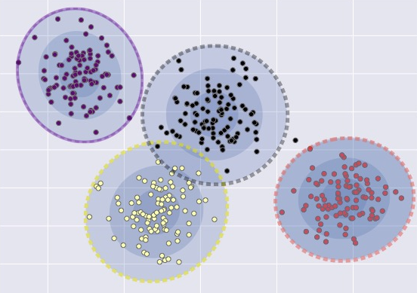
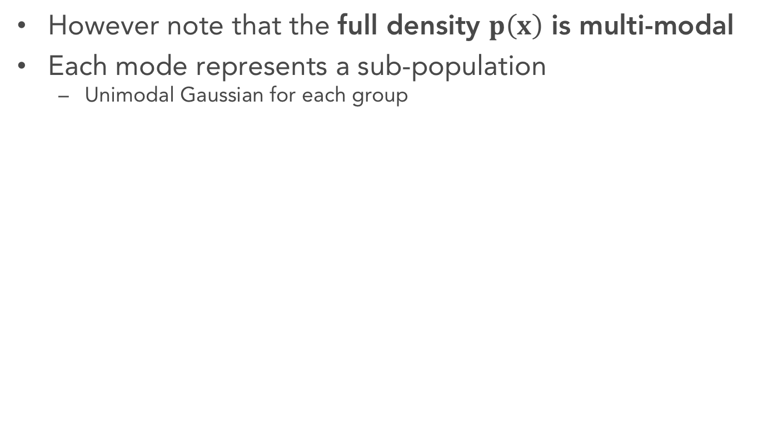
Probabilistic interpretation of clustering
How can we define this problem
We can define one Gaussian distribution per cluster
So we have each of the
However note that the full density $p\left(x\right)$ is multi-modal
Each mode represents a sub-population
Unimodal Gaussian for each group
Mixing coefficients
Unimodal

Slide 17
Probabilistic interpretation of clustering
How to optimize this problem
We obtain a similar issue as we had with K-Means
If we knew the cluster parameters
Then estimating is easy
And also consequently estimating
Maximum likelihood estimation
This is Naïve Bayes

Slide 18
Probabilistic interpretation of clustering
How to optimize this problem
We obtain a similar issue as we had with K-Means
But in reality, we do not have access to
Now estimating and is hard
We need to address a much more complex problem
Need to resort to a similar alternating approach
?
?
?
?

Slide 19
Expectation-Maximization
Introducing Expectation-Maximization (EM)
Provides a solution to our hard problem
When all data is observable
Use the Maximum likelihood estimator
Optimize the analytic form of
For missing (latent) data
The full data is (observed) and (latent)
The likelihood becomes
Performing optimization
As the likelihood is intractable in most cases
We are going to approximate it

Slide 20
Expectation-Maximization
EM tries to iteratively maximize likelihood
The complete likelihood is
Start from a random initial guess
Then iteratively apply (until convergence)
E-step: compute the expectation of the likelihood
This function is called the Q-function
M-step: compute by maximizing the Q-function

Slide 21
Expectation-Maximization
EM tries to iteratively maximize likelihood
To summarize the algorithm in simple terms
Start from a random initial guess
Then iteratively apply (until convergence)
E-step: use the current parameters (and observations) to reconstruct the hidden (latent) structure
M-step: use that hidden structure (and observations) to re-estimate the parameters
Very similar to the simple K-means
Consists of assignment and updates
Can use random initialization
Problem of local minima

Slide 22
Required tools for EM
What we need to derive the EM algorithm
Write the likelihood of the complete data (decide distribution)
E-step: write the Q function (expectation given the observed data)
M-step: solve maximization (deriving closed-form solution if possible)
Usually the Q-function is too complex to obtain directly
We are going to approximate it with several mathematical tools
Notion of lower-bounding functions
Kullback-Leibler divergence
Jensen’s inequality

Slide 23
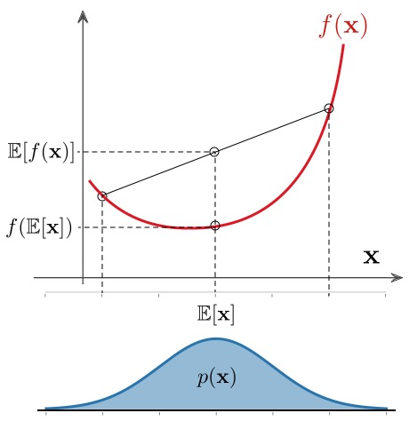
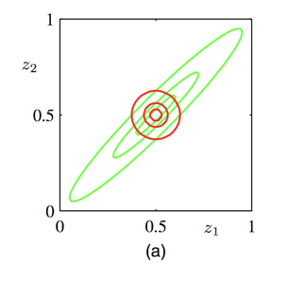
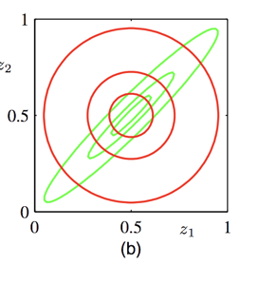
Background knowledge
Jensen inequality
If is a convex function
Kullback-Leibler divergence
Measure of statistical difference between distributions

Slide 24
Expectation Maximization
Writing down the E(xpectation)-Step
We want to maximize the data likelihood
However, distribution might be too complex
If we can find a simpler lower bound
Then we know that
Problem: Quality of lower-bound dictates quality of approx.
Instead of finding a fixed lower-bound
We aim to define a parametric distribution
Then, we can minimize the difference to our function

Slide 25
Intuitive understanding of lower bounding
Understanding the idea behind lower bounding
How do we optimize the approximation
Lower bound
Easier to optimize
Guaranteed to improve likelihood
Complicated
Likelihood
next guess
current guess
E-step = computing the lower bound
M-step = maximizing the lower bound

Slide 26
Expectation Maximization
How to maximize likelihood by pushing the lower bound ?
We can introduce directly the distribution
Jensen's inequality
Constant with respect to
Negative KL-divergence
Our final expression is simply

Slide 27
Expectation-Maximization
Optimizing the lower bound with respect to
KL-divergence is non-negative, and equals to zero when
Note: the calculation of is based on current
Therefore our optimal solution is simply
Next, we can optimize the parameters in the M-Step

Slide 28
Properties of EM
Note that the global optimal is not guaranteed
Likelihood is usually non-convex
EM is a greedy algorithm (alternative ascent)
Generalized EM
E-step:
M-step: choose that improves
We will now move to a more general EM formulation
We have explicitly assumed is Gaussian
However, we noted that is multi-modal
This defines Gaussian Mixture Models (GMM)

